Slide 1

Prospect theory applications
Notes on Behavioural Economics
Jason Collins

Slide 2
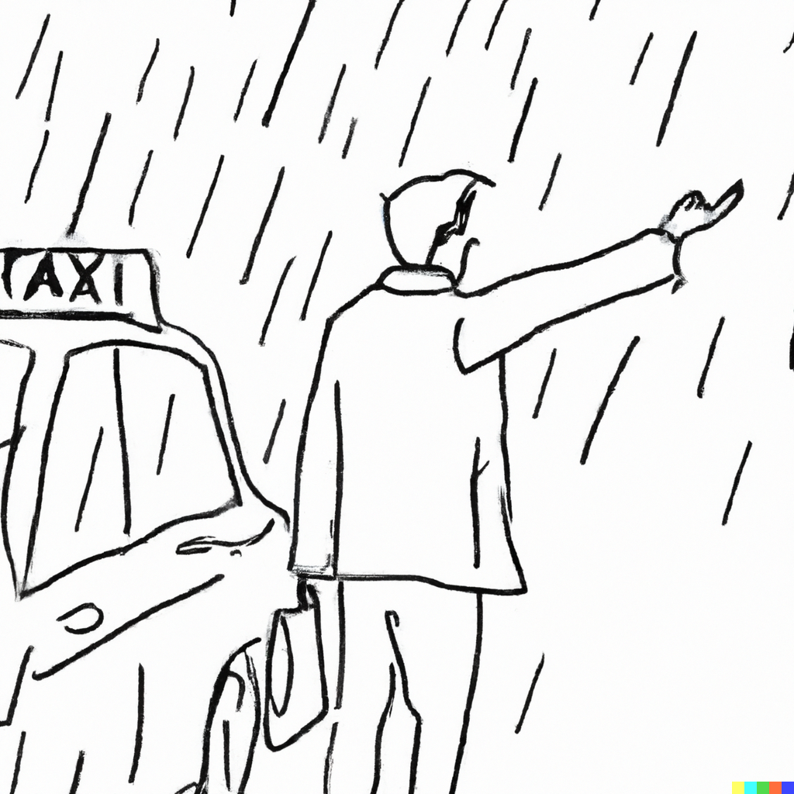

Slide 3
Taxi driver behaviour on rainy days
“Narrow bracketing”
How much should I work today?
How much should I work each day this week?

Slide 4
Taxi driver behaviour on rainy days
Farber (2005): The decision to stop work was primarily a function of how many hours had been worked up to that point in the day.
Farber (2008): a model of labour supply with reference-dependent targets has a better fit than a standard neoclassical model.
Farber (2015): taxi drivers drive more when they can earn more.
Farber (2005) “Is tomorrow another day? The labor supply of New York City cabdrivers”, Journal of Political Economy, 113(1), 46-82
Farber (2008) “Reference-dependent preferences and labor supply: The case of New York City taxi drivers”, American Economic Review, 98(3), 1069-82
Farber (2015) “Why you Can’t Find a Taxi in the Rain and Other Labor Supply Lessons from Cab Drivers”, The Quarterly Journal of Economics,130(4), 1975–2026, https://doi.org/10.1093/qje/qjv026

Slide 5
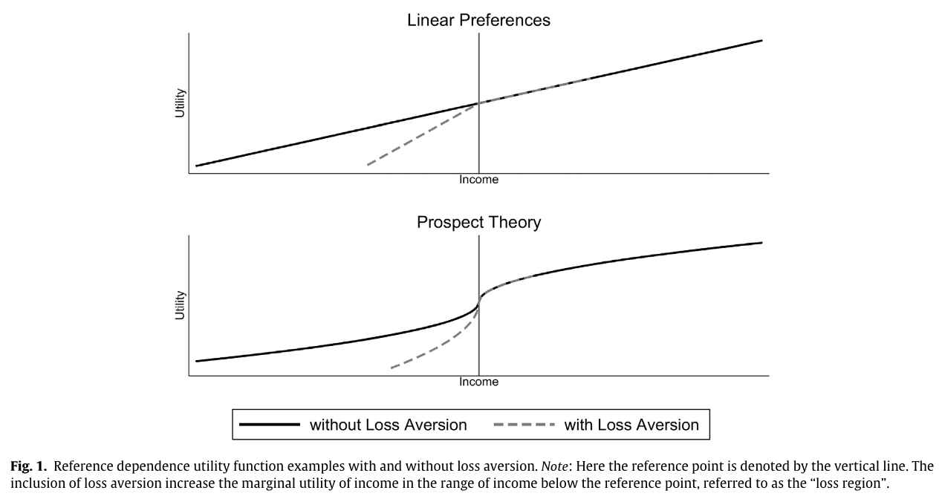
Taxi driver behaviour on rainy days
Martin (2017) “When to quit: Narrow bracketing and reference dependence in taxi drivers”, Journal of Economic Behavior & Organization, 144, 166–187, https://doi.org/10.1016/j.jebo.2017.09.024

Slide 6
The disposition effect
The disposition effect is the tendency for investors to sell stocks that are in the gain domain relative to the purchase price and to hold stocks that are in the loss domain.

Slide 7
The disposition effect
[C]onsider an investor who purchased a stock one month ago for $50 and who finds that the stock is now selling at $40. The investor must now decide whether to realize the loss or hold the stock for one more period. To simplify the discussion, assume that there are no taxes or transaction costs. In addition, suppose that one of two equiprobable outcomes will emerge during the coming period: either the stock will increase in price by $10 or decrease in price by $10. According to prospect theory, our investor frames his choice as a choice between the following two lotteries:
A. Sell the stock now, thereby realizing what had been a $10 "paper loss".
B. Hold the stock for one more period, given 50-50 odds between losing an additional $10 or "breaking even."
Shefrin and Statman (1985) “The Disposition to Sell Winners Too Early and Ride Losers Too Long: Theory and Evidence”, The Journal of Finance, 40(3), 777–790, https://doi.org/10.1111/j.1540-6261.1985.tb05002.x

Slide 8
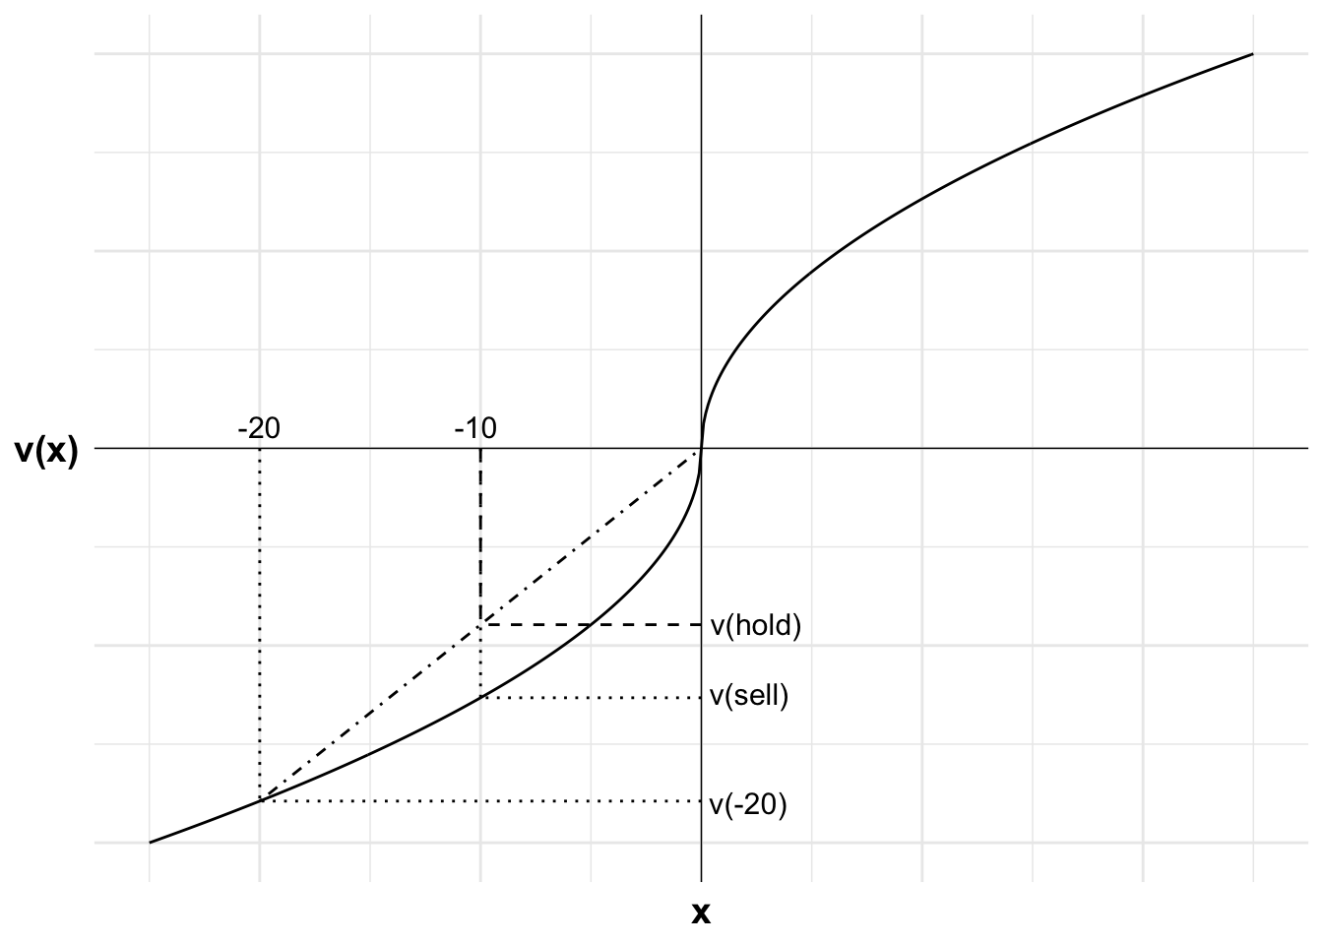
The disposition effect

Slide 9
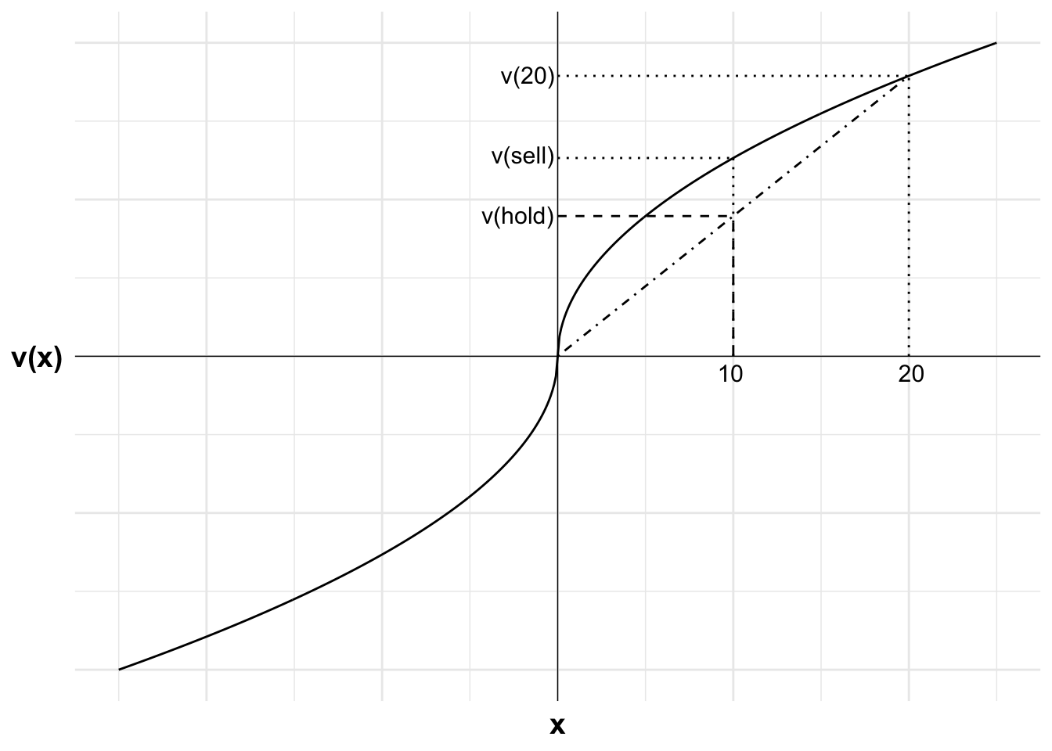
The disposition effect

Slide 10


